Slide 1
Super Powers of Time Series -
an introduction to auto regressive models

Slide 2


Agenda
Recap of previous session
Basic Concepts of Time series modelling –
1. Stationary Time Series
2. Random Walk process
3. Unit root
Autoregressive Series
Moving Average Series
Partial Autocorrelation
Identifying Time Series Models
Model Generalization
Fitting and Forecasting

Slide 3
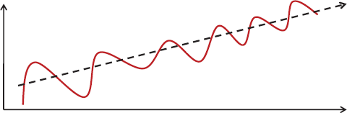
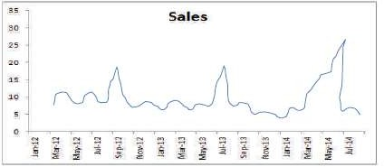
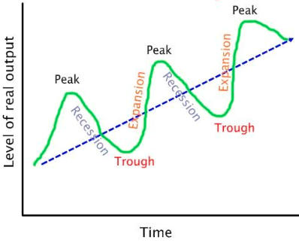
Recap of previous session
Additive Time Series :
Xt = St + Tt + Ct + I
Multiplicative Time Series
Xt = St . Tt. Ct . I
Trend
Seasonality
Cyclicality
Irregularity
Smoothing Methods
1. Simple Moving Average
2. Weighted Moving Averages (WMA)
3. Exponential Smoothing Method
4. Holt-Winters Methods
5. Measuring Forecast Accuracy
Github: https://github.com/bhaskatripathi/Timeseriesbasics

Slide 4
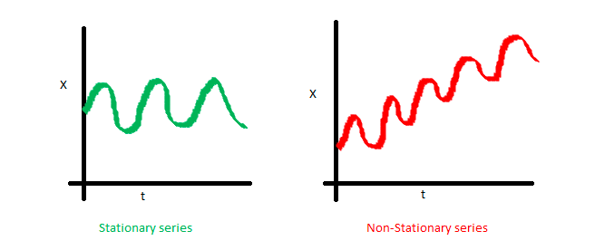
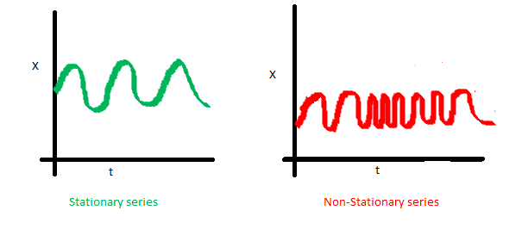
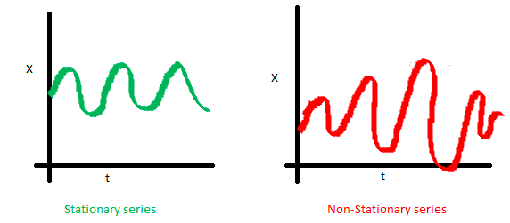
Basic Concepts of Time series modelling - Stationarity
Statistical stationarity: A stationary time series is one whose statistical properties such as mean, variance, autocorrelation are constant over time
Mean of the series should not be a function of time rather should be a constant
Variance of the series should not a be a function of time. This property is known as homoscedasticity
Covariance of the i th term and the (i + m) th term should not be a function of time

Slide 5
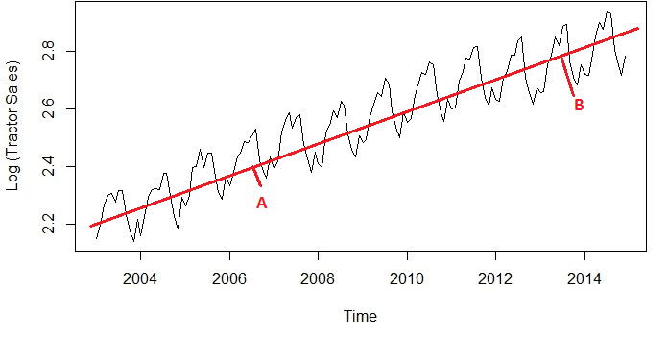
Stationarity
Statistical stationarity: A stationary time series is one whose statistical properties such as mean, variance, autocorrelation are constant over time
Non Stationary Series

Slide 6
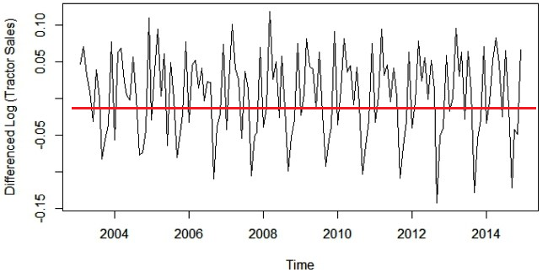
Stationarity
A weekly stationary process – No Trend and fluctuates around a constant mean
Notes:
Practitioners say that the stationary time-series is the one with no trend - fluctuates around the constant mean and has constant variance.
Covariance between different lags is constant, it doesn't depend on absolute location in time-series. For example, the covariance between t and t-1 (first order lag) should always be the same (for the period from 1960-1970 same as for the period from 1965-1975 or any other period).
In non-stationary processes there is no long-run mean to which the series reverts; so we say that non-stationary time series do not mean revert. In that case, the variance depends on absolute position in time-series and variance goes to infinity as time goes on. Technically speaking, auto-correlations to not decay with time, but in small samples they do disappear - although slowly.
In stationary processes, shocks are temporary and dissipate (lose energy) over time. After a while, they do not contribute to the new time-series values. For example, something which happened log time ago (long enough) such as World War II, had an impact, but, it the time-series today is the same as if World War II never happened, we would say that shock lost its energy or dissipated. Stationarity is especially important as many classical econometric theories are derived under the assumptions of stationarity.
A strong form of stationarity is when the distribution of a time-series is exactly the same trough time. In other words, the distribution of original time-series is exactly same as lagged time-series (by any number of lags) or even sub-segments of the time-series. For example, strong form also suggests that the distribution should be the same even for a sub-segments 1950-1960, 1960-1970 or even overlapping periods such as 1950-1960 and 1950-1980. This form of stationarity is called strong because it doesn't assume any distribution. It only says the probability distribution should be the same. In the case of weak stationarity, we defined distribution by its mean and variance. We could do this simplification because implicitly we assumed normal distribution, and normal distribution is fully defined by its mean and variance or standard deviation. This is nothing but saying that probability measure of the sequence (within time-series) is the same as that for lagged/shifted sequence of values within same time-series.

Slide 7


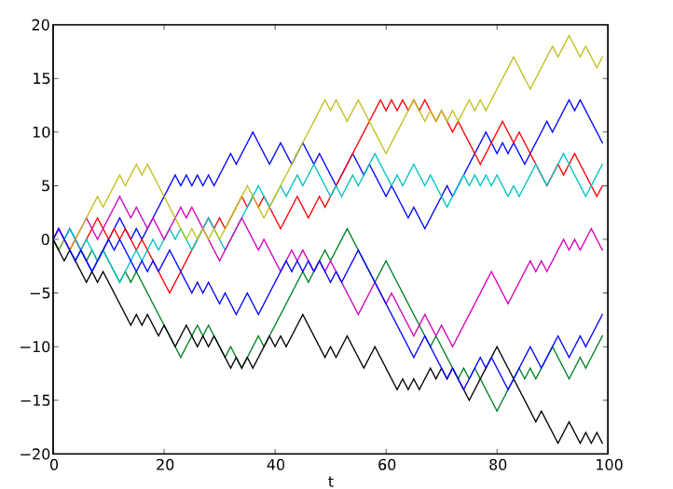

Random walk
Random walk is defined as a process where the current value of a variable is composed of the past value. plus an error term defined as a white noise

Slide 8
White Noise Series
A purely random series
Notes:
Practitioners say that the stationary time-series is the one with no trend - fluctuates around the constant mean and has constant variance.
Covariance between different lags is constant, it doesn't depend on absolute location in time-series. For example, the covariance between t and t-1 (first order lag) should always be the same (for the period from 1960-1970 same as for the period from 1965-1975 or any other period).
In non-stationary processes there is no long-run mean to which the series reverts; so we say that non-stationary time series do not mean revert. In that case, the variance depends on absolute position in time-series and variance goes to infinity as time goes on. Technically speaking, auto-correlations to not decay with time, but in small samples they do disappear - although slowly.
In stationary processes, shocks are temporary and dissipate (lose energy) over time. After a while, they do not contribute to the new time-series values. For example, something which happened log time ago (long enough) such as World War II, had an impact, but, it the time-series today is the same as if World War II never happened, we would say that shock lost its energy or dissipated. Stationarity is especially important as many classical econometric theories are derived under the assumptions of stationarity.
A strong form of stationarity is when the distribution of a time-series is exactly the same trough time. In other words, the distribution of original time-series is exactly same as lagged time-series (by any number of lags) or even sub-segments of the time-series. For example, strong form also suggests that the distribution should be the same even for a sub-segments 1950-1960, 1960-1970 or even overlapping periods such as 1950-1960 and 1950-1980. This form of stationarity is called strong because it doesn't assume any distribution. It only says the probability distribution should be the same. In the case of weak stationarity, we defined distribution by its mean and variance. We could do this simplification because implicitly we assumed normal distribution, and normal distribution is fully defined by its mean and variance or standard deviation. This is nothing but saying that probability measure of the sequence (within time-series) is the same as that for lagged/shifted sequence of values within same time-series.

Slide 9
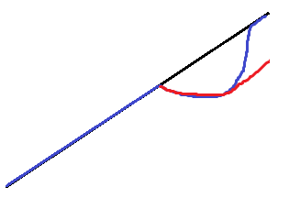
Unit Root
A Unit root (also called a unit root process or a difference stationary process) is a stochastic trend in a time series, sometimes called a “random walk with drift”
If a time series has a unit root, it shows a systematic pattern that is unpredictable. A possible unit root.
Red line shows the drop in output and path of recovery if the time series has a unit root.
Blue shows the recovery if there is no unit root and the series is trend-stationary.
ADF Test – H0 for this test is that the series has a unit root
Notes:
Practitioners say that the stationary time-series is the one with no trend - fluctuates around the constant mean and has constant variance.
Covariance between different lags is constant, it doesn't depend on absolute location in time-series. For example, the covariance between t and t-1 (first order lag) should always be the same (for the period from 1960-1970 same as for the period from 1965-1975 or any other period).
In non-stationary processes there is no long-run mean to which the series reverts; so we say that non-stationary time series do not mean revert. In that case, the variance depends on absolute position in time-series and variance goes to infinity as time goes on. Technically speaking, auto-correlations to not decay with time, but in small samples they do disappear - although slowly.
In stationary processes, shocks are temporary and dissipate (lose energy) over time. After a while, they do not contribute to the new time-series values. For example, something which happened log time ago (long enough) such as World War II, had an impact, but, it the time-series today is the same as if World War II never happened, we would say that shock lost its energy or dissipated. Stationarity is especially important as many classical econometric theories are derived under the assumptions of stationarity.
A strong form of stationarity is when the distribution of a time-series is exactly the same trough time. In other words, the distribution of original time-series is exactly same as lagged time-series (by any number of lags) or even sub-segments of the time-series. For example, strong form also suggests that the distribution should be the same even for a sub-segments 1950-1960, 1960-1970 or even overlapping periods such as 1950-1960 and 1950-1980. This form of stationarity is called strong because it doesn't assume any distribution. It only says the probability distribution should be the same. In the case of weak stationarity, we defined distribution by its mean and variance. We could do this simplification because implicitly we assumed normal distribution, and normal distribution is fully defined by its mean and variance or standard deviation. This is nothing but saying that probability measure of the sequence (within time-series) is the same as that for lagged/shifted sequence of values within same time-series.

Slide 10
ARIMA Model
Auto Regressive Integrated Moving Average - (Hyndman & Khandakar, 2008)
Auto Regressive : Lags of the stationarized series are called “autoregressive” (AR) terms
Moving Average : Lags of the forecast errors are called “moving average” (MA) terms
Integrated : A series which needs to be differenced to be made stationary is an “integrated” (I) series
Generalized random walk models fine-tuned to eliminate all residual autocorrelation
Generalized exponential smoothing models that can incorporate long-term trends and seasonality
Stationarized regression models that use lags of the dependent variables and/or lags of the forecast errors as regressors
The most general class of forecasting models for time series that can be stationarized by transformations such as differencing, logging, and or deflating
Notes:
Practitioners say that the stationary time-series is the one with no trend - fluctuates around the constant mean and has constant variance.
Covariance between different lags is constant, it doesn't depend on absolute location in time-series. For example, the covariance between t and t-1 (first order lag) should always be the same (for the period from 1960-1970 same as for the period from 1965-1975 or any other period).
In non-stationary processes there is no long-run mean to which the series reverts; so we say that non-stationary time series do not mean revert. In that case, the variance depends on absolute position in time-series and variance goes to infinity as time goes on. Technically speaking, auto-correlations to not decay with time, but in small samples they do disappear - although slowly.
In stationary processes, shocks are temporary and dissipate (lose energy) over time. After a while, they do not contribute to the new time-series values. For example, something which happened log time ago (long enough) such as World War II, had an impact, but, it the time-series today is the same as if World War II never happened, we would say that shock lost its energy or dissipated. Stationarity is especially important as many classical econometric theories are derived under the assumptions of stationarity.
A strong form of stationarity is when the distribution of a time-series is exactly the same trough time. In other words, the distribution of original time-series is exactly same as lagged time-series (by any number of lags) or even sub-segments of the time-series. For example, strong form also suggests that the distribution should be the same even for a sub-segments 1950-1960, 1960-1970 or even overlapping periods such as 1950-1960 and 1950-1980. This form of stationarity is called strong because it doesn't assume any distribution. It only says the probability distribution should be the same. In the case of weak stationarity, we defined distribution by its mean and variance. We could do this simplification because implicitly we assumed normal distribution, and normal distribution is fully defined by its mean and variance or standard deviation. This is nothing but saying that probability measure of the sequence (within time-series) is the same as that for lagged/shifted sequence of values within same time-series.

Slide 11
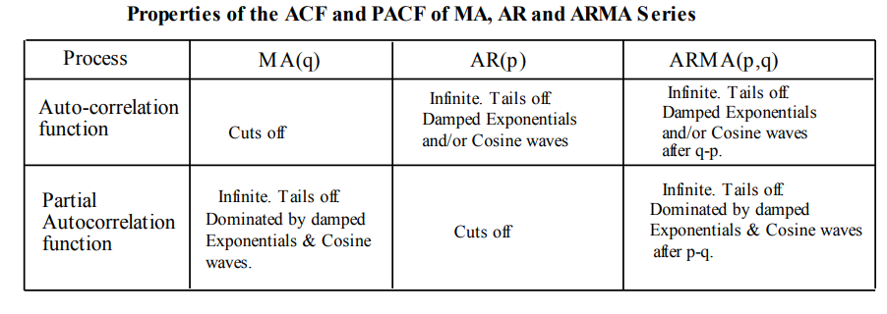
ARIMA Process
ARIMA(p,d,q) model
p = order of the autoregressive part;
d = degree of first differencing involved;
q = order of the moving average part.
We use ACF and PACF Graphs to determine the values of p and q :

Slide 12
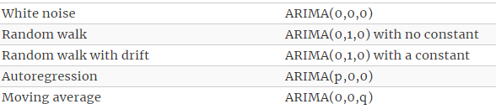
ARIMA Process
ARIMA(p,d,q) model
p = order of the autoregressive part;
d = degree of first differencing involved;
q = order of the moving average part.

Slide 13
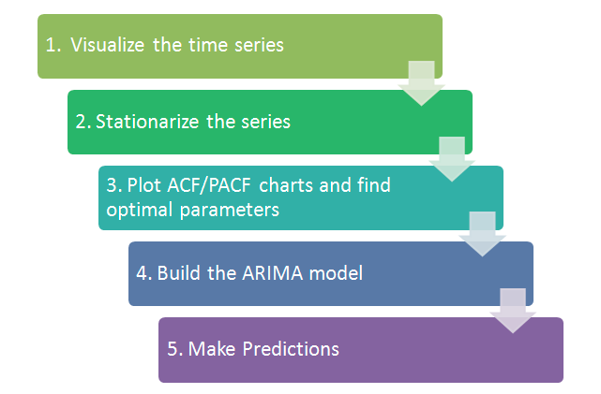
ARIMA Algorithm framework
Choose Models with:
1. Most Significant Coefficients
2. Least Volatility
3. Lowest AIC and BIC values
4. Highest Adjusted R square

Slide 14
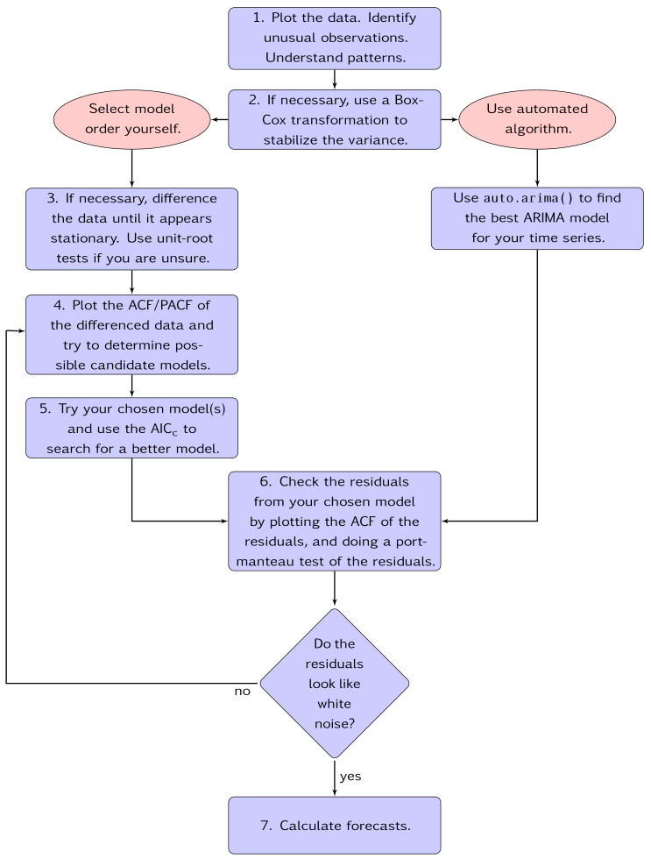
ARIMA Flowchart

Slide 15

Thank YOU

